Slide 1
Good practice in Research Data Management
Module 5:
Deposit and long-term preservation

Slide 2
Topics
Considering the long-term
Data Centres and repositories
Metadata and the Newcastle University Research Data Catalogue

Slide 3
Considering the long-term

Slide 4
Distinctions and definitions
Digital archiving
  Concerned with backup and maintenance
Digital preservation
  Concerned with maintaining access
Digital curation
  Concerned with the holistic range of processes applied to data over its lifecycle

Slide 5
What is digital curation?
“Digital curation, broadly interpreted, is about maintaining and adding value to a trusted body of digital information for current and future use.” (DCC)

Slide 6
What is digital curation? #2
“Digital curation is concerned with actively managing data for as long as it continues to be of scholarly, scientific, research and/or administrative interest, with the aim of supporting reproducibility of results, reuse of and adding value to that data, managing it from its point of creation until it is determined not to be useful, and ensuring its long-term accessibility and preservation, authenticity and integrity.”
(DCC Digital Curation 101, p3)

Slide 7
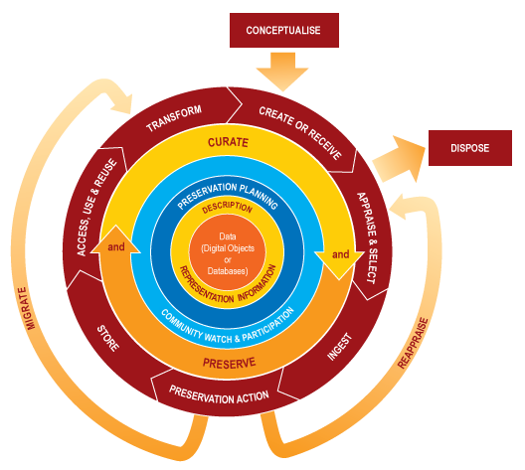
DCC Curation lifecycle model

Slide 8
Key questions
Where will you deposit your data for the long-term?
Will you embargo the use of your data?
  Why?
  How long for?

Slide 9
Why is long-term preservation important?
Access, use and re-use
  for you and for others
More impact
More citations
More opportunities for collaboration

Slide 10
Data Centres and repositories

Slide 11
Where do I deposit my data?
Funder mandated data centre or repository
Subject repository
National data centre

Slide 12
Example funder mandated data centres / repositories
A few of many…
  UK Data Service - Economic and Social Data
    http://www.ukdataservice.ac.uk/
  NERC data centres (x7)
    http://www.nerc.ac.uk/research/sites/data/
  European Nucleotide Archive (European Bioinformatics Institute)
    http://www.ebi.ac.uk/ena/
  MRC Research Data Gateway
    https://www.datagateway.mrc.ac.uk/
  UK Data Archive for the social sciences
    http://data-archive.ac.uk/
More information
  http://research.ncl.ac.uk/rdm/policyandgovernance/nationaldatacentres/

Slide 13
Benefits of depositing data in a data centre or repository
Increased efficiently - save time and money
All the data in one place = larger datasets for analysis
Reduced risk of duplication of effort
Data centre protocols help ensure that data is produced in a format that is valuable to researchers

Slide 14
Example subject repositories
Can be open, or funder mandated
  Archaeology Data Service
  MIMAS
  Data DRYAD
  DataCite
  Re3data
  Chemical Database Service

Slide 15
Metadata and the Newcastle University Research Data Catalogue

Slide 16
What is metadata?
It's "data about data"!
Explains the origin, purpose, time reference, geographic location, creator, access conditions and terms of use of a data collection
Metadata are typically used:
  for resource discovery, providing searchable information that helps users to easily find existing data
  as a bibliographic record for citation

Slide 17
Working with metadata
When depositing in an archive or with a data centre
  A metadata template, structured to international standards or schemes, normally provided
Metadata powers resource discovery
  Via meaningful dataset titles, descriptions, keywords and other information

Slide 18
Example funder stipulation:
EPSRC Principle 6
“Sufficient metadata should be recorded and made openly available to enable other researchers to understand the potential for further research and re-use of the data. Published results should always include information on how to access the supporting data.”
http://www.epsrc.ac.uk/about/standards/researchdata/Pages/principles.aspx

Slide 19
Activity: How much metadata is "Sufficient metadata"?
Activity reused under cc-by-sa license form RDM Rose, Jisc project 2012-13, University of Sheffield

Slide 20
Metadata scenario
The University of Poppleton holds a dataset with meteorological observations, taken at the university’s weather station. In particular, it contains a set of precipitation measurements since the foundation of the university. A climatologist, Jenny Fairweather, is interested in this dataset for her research into climate change. She is looking for trends in the weather. A meteorologist, Wilson Rainbird, who works for the UK Met Office wants to use these data for the purposes of weather prediction. He is mainly interested in combining these precipitation measurements with other similar datasets. A researcher, Alice Snowe, from another university’s Accident Research Unit conducts most of her research in the area of road traffic accidents. She would like to map the precipitation measurements to another dataset containing information on road accidents in order to analyse possible correlations. Lastly, the university’s data repository manager, John Shower, is concerned with issues regarding data access and IPR.

Slide 21
Questions to consider
What metadata descriptors can you identify?
Which does each stakeholder require?
What is “sufficient metadata” to enable other researchers to understand the potential for further research and re-use of the dataset?

Slide 22
3 levels of metadata
Mandatory minimal metadata
  to enable basic discovery, such as Creator, Title, Publisher, Date, Location, Access terms & conditions
Mandatory contextual metadata (mostly administrative and based on funders expectations)
  such as Funding Agency, Grant Number, Last access request date, Project Information, Data Generation Process, Why the data was generated, Date (range) of data collection, Reasons for embargo
Optional metadata (including discipline-specific metadata)
  to enable reuse, such as machine settings and experimental conditions under which the data were gathered

Slide 23
HEIs and metadata
Universities need to have a record of the research data they hold
They make the metadata available online to support discoverability and re-use

Slide 24
Introducing the Newcastle University Research Data Catalogue (RDC)
The Newcastle University RDC is a proof of concept metadata catalogue
  It's not a repository for data!
RDC facilitates RDM implementation

Slide 25
RDC enabling RDM
RDC enables the publications held on MyImpact to be linked to the projects that supported the research held on MyProjects
supports RDM draft policy implementation
  By recording information such as data location, access to publications, internal discoverability of data, and embargo periods restricting the re-use of data

Slide 26
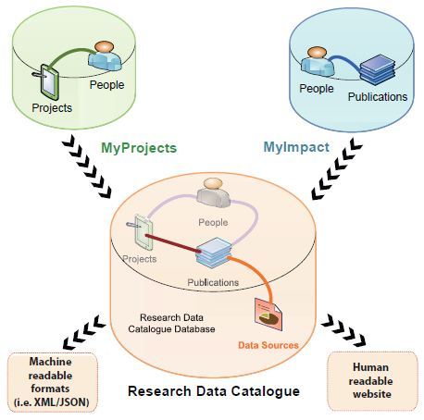
RDC visualised

Slide 27
RDC: More information
RDC explained on RDM at Newcastle website
  http://research.ncl.ac.uk/rdm/tools/researchdatacatalogue/
RDC overview and getting started guide (pdf)
RDC poster (pdf)

Slide 28
Session review

Slide 29
In summary
Depositing data and long-term preservation is both important and beneficial
Data Centres and repositories are often funder mandated and prescribe metadata template
Metadata powers resource discovery
Newcastle's RDC facilitates RDM implementation

Slide 30
Acknowledgemets
Digital Curation Centre (DCC)
  http://www.dcc.ac.uk/training
RDM Rose, Jisc project 2012-13, University of Sheffield
  http://www.sheffield.ac.uk/is/research/projects/rdmrose

